Slide 1
Unit 10 Live Session Assignment
Ben Goodwin

Slide 2
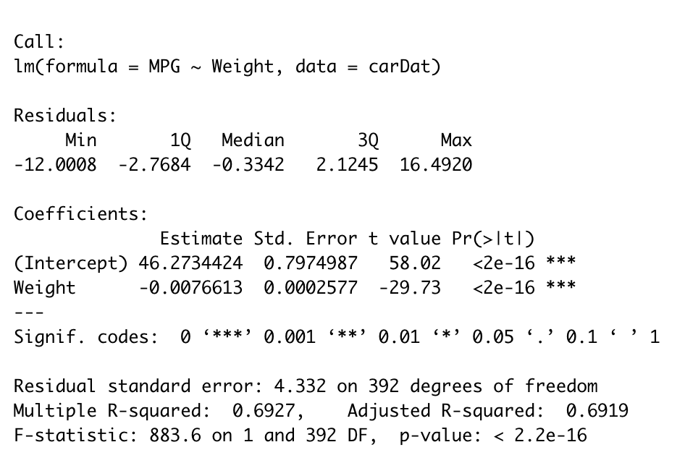
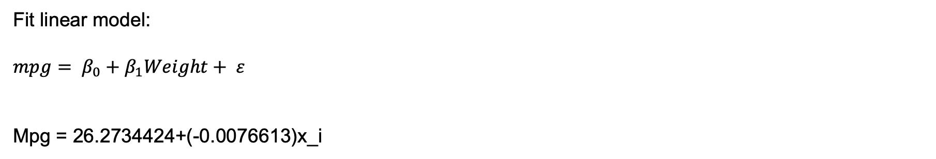
Question 1, simple linear model
Fit linear model:
$$mpg= β_{0}+β_{1}Weight+ ε$$
Mpg = 26.2734424+(-0.0076613)x_i

Slide 3
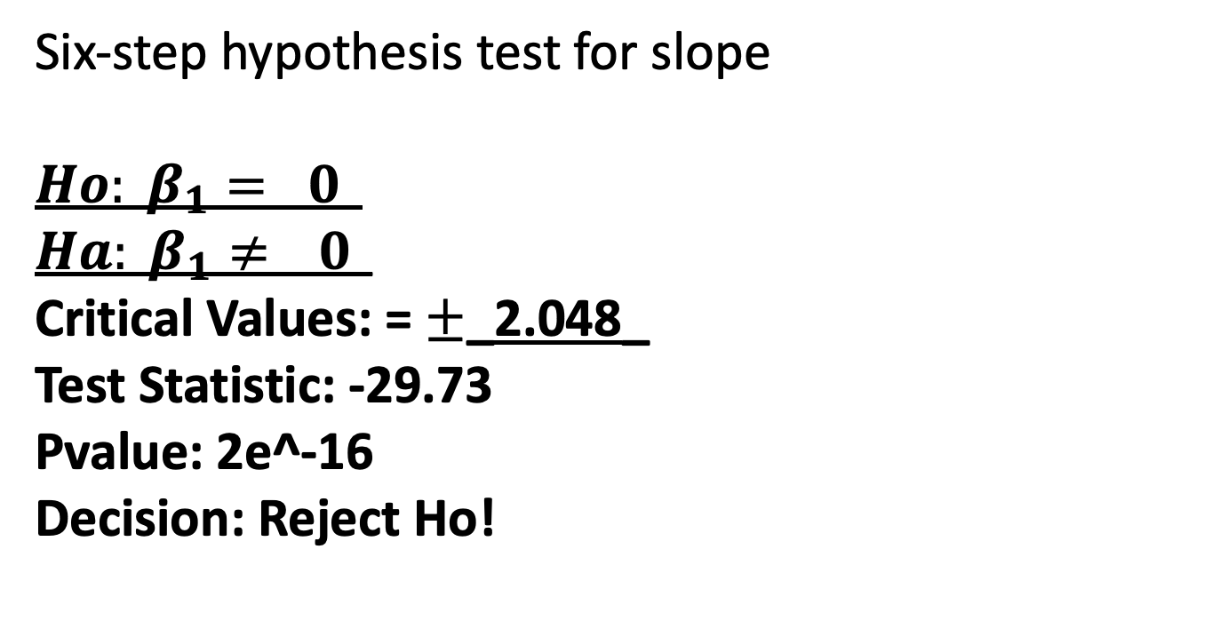
Question 1, simple linear model for
Six-step hypothesis test for slope
$$Ho: β_{1}= 0_$$
$$Ha: β_{1}≠ _0_$$
Critical Values: = $±$_2.048_
Test Statistic: -29.73
Pvalue: 2e^-16
Decision: Reject Ho!
95% CI for slope:
(-0.008168061,-0.007154609)

Slide 4
Question 1, simple linear model for
Slope interpretation: Each 1 unit increase in weight results in a 0.0076613 decrease in MPG.
95% CI for slope:
(-0.008168061,-0.007154609)

Slide 5
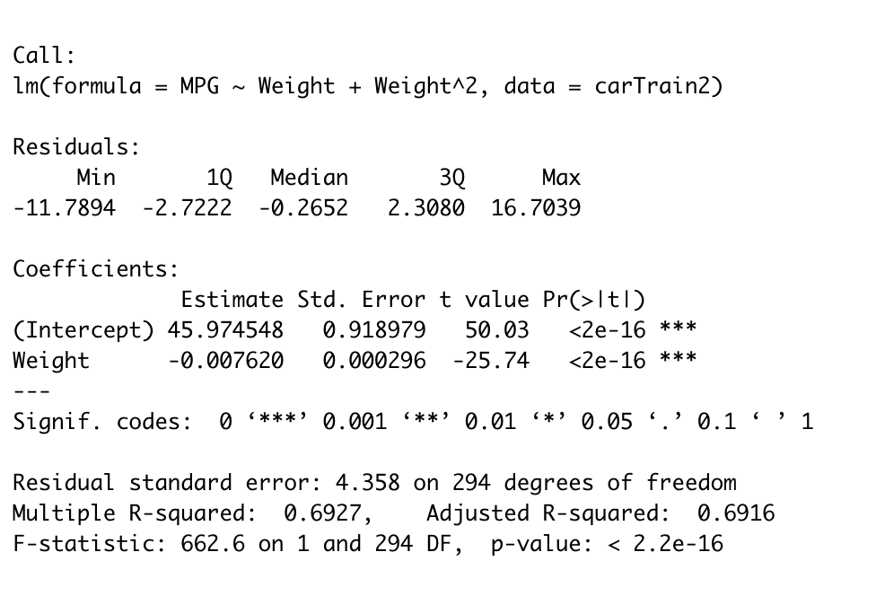
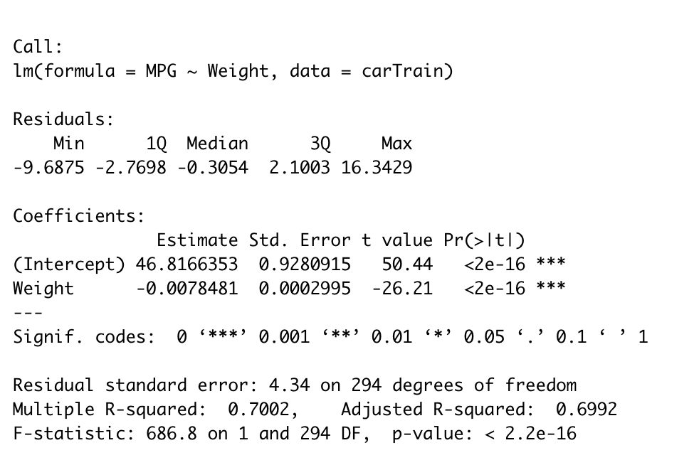
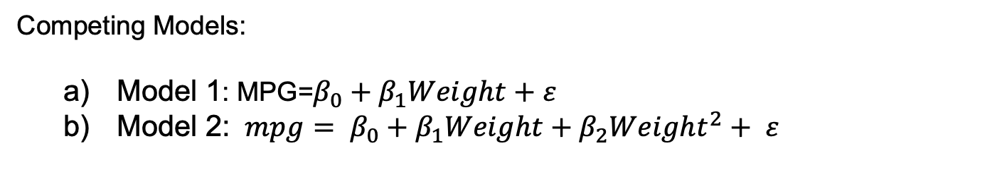
Question 2
Competing Models:
Model 1: MPG=$β_{0}+β_{1}Weight+ε$
Model 2: $mpg= β_{0}+β_{1}Weight+β_{2}{Weight}^{2}+ ε$
Model 1
Model 2

Slide 6
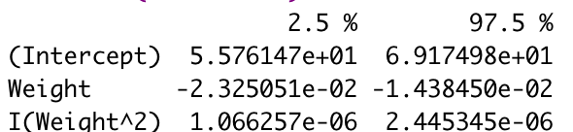
Question 2
Competing Models:
Model 2 is favored by cross-validation, due to its lower MPSE.
Mean 18.66 MPSE Model 1
Mean 17.33 MPSE Model 2
Describe the relationship between miles per gallon and the weight of the car:
MPG= 5.576147-2.325051e^-2+1.066257e^-6
Slope interpretation: Each 1 unit increase in weight results in a -2.325051 decrease in MPG.
Intercept interpretation: We expect a car with 0 weight to get 5.576147 MPG
95% CI:

Slide 7
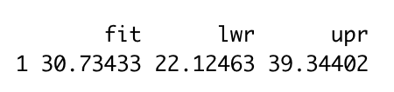
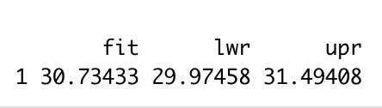
Question 2
R input (Favored model is model 2):
New Data frame for 2000lbs car
new.car <- data.frame(Weight = c(2000))
Confidence Interval for 2000lbs car prediction
predict(Model2_fit, newdata = new.car,interval = "confidence",level = 0.95)
Prediction Interval for 2000lbs car prediction
predict(Model2_fit, newdata = new.car, interval = "prediction",level = 0.95)
R output for Confidence Interval
R output for Prediction Interval

Slide 8
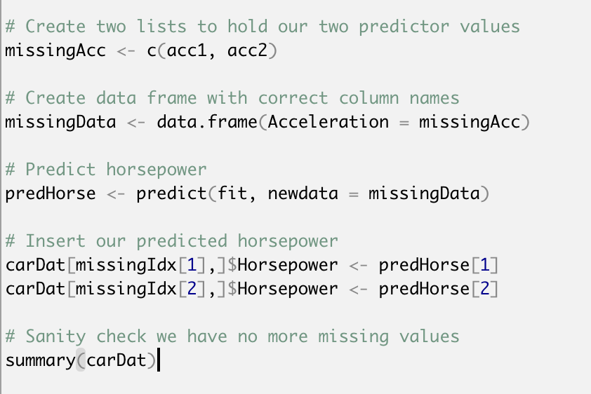
Question 3
Impute (predict and insert) the missing horsepower by fitting a regression model.

Slide 9
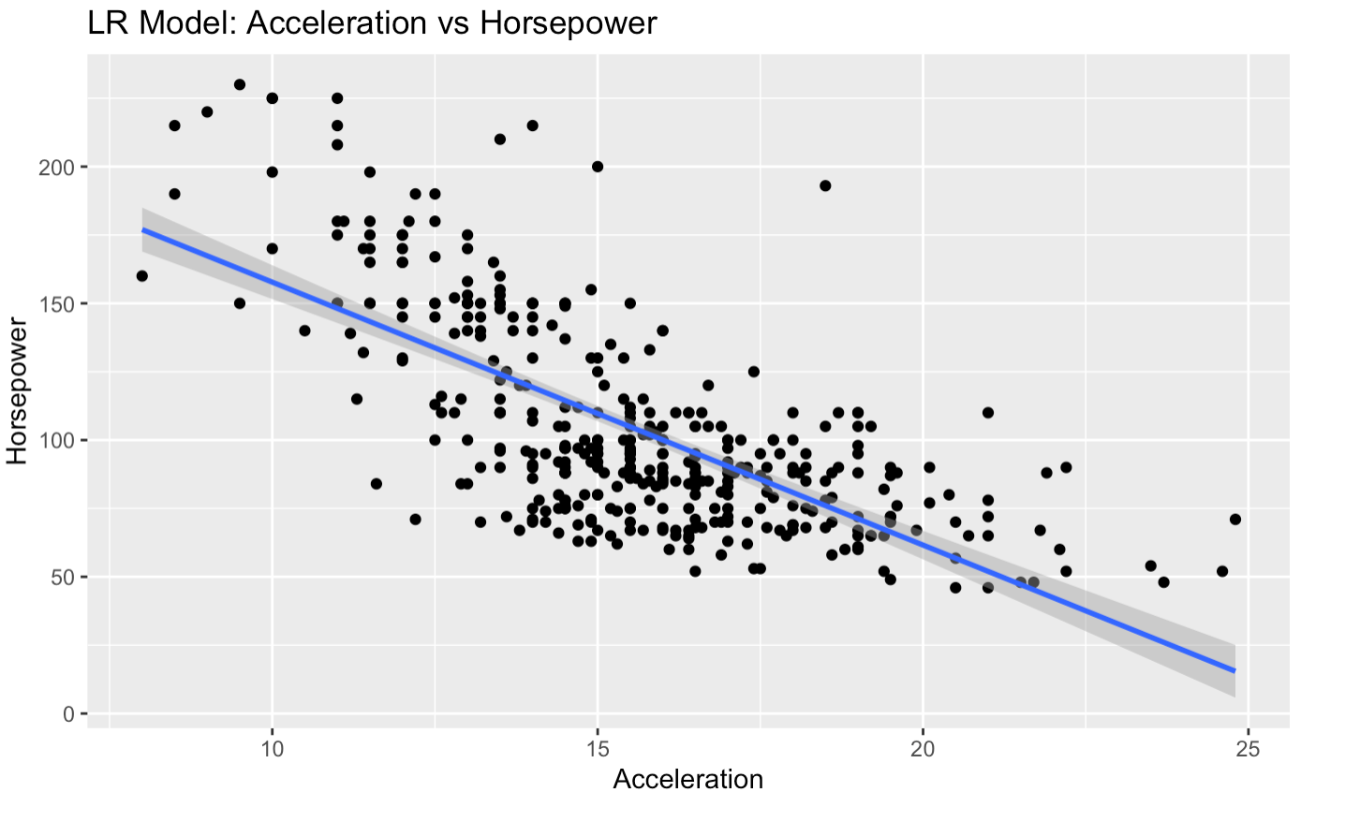
Question 3

Slide 10
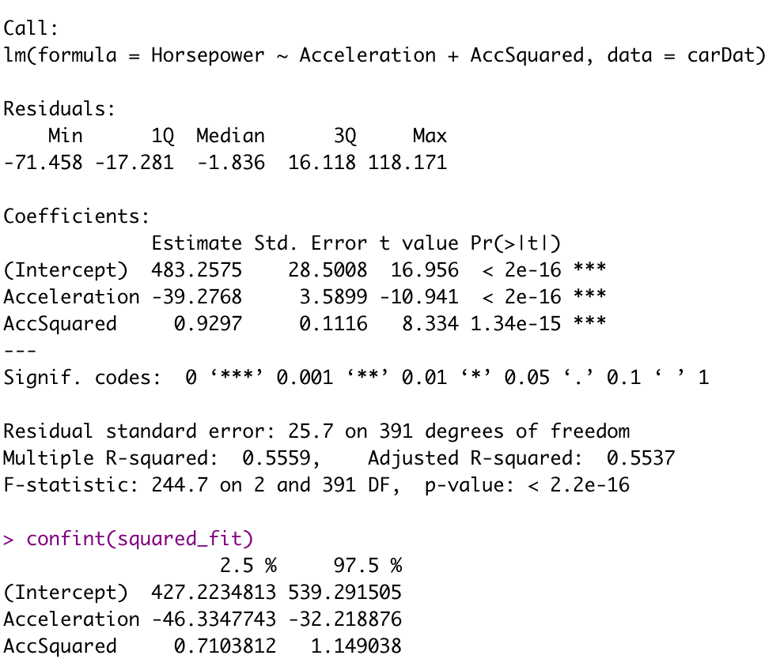
Question 3

Slide 11
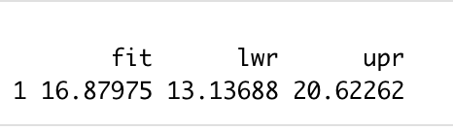
Question 3
Mean MPG for a car with 250hp

